Slide 1
July 11th Meeting
Ainsley Lai

Slide 2
Agenda
Source Level histograms
SEL (Rx Level) vs. Range
Extended Spectrograms
Comparing SPDFs of diff. location
Axial Base + Central Caldera
3 MMSIs found in both locations

Slide 3
MMSI 356190000

Slide 4
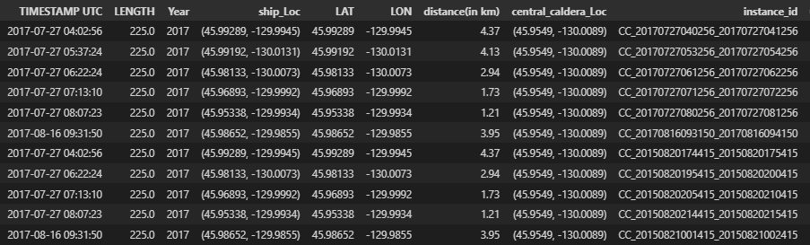
MMSI 356190000 CC
Note/concern about SPDFs
Timestamps repeat after certain point but may use different instance ID

Slide 5
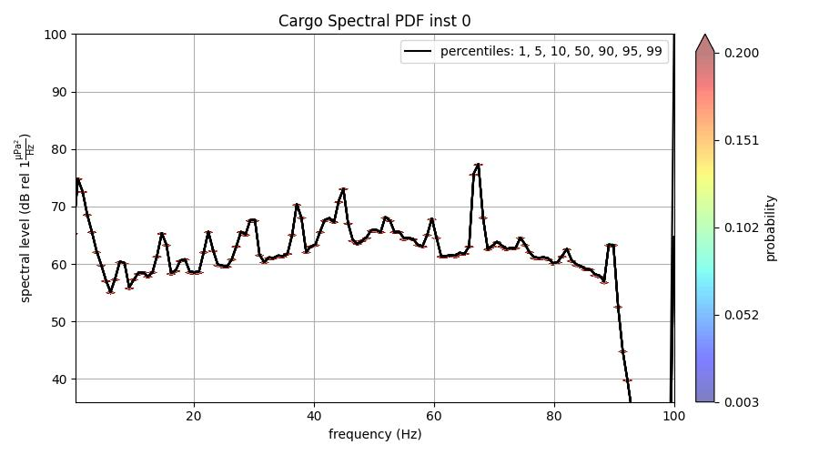
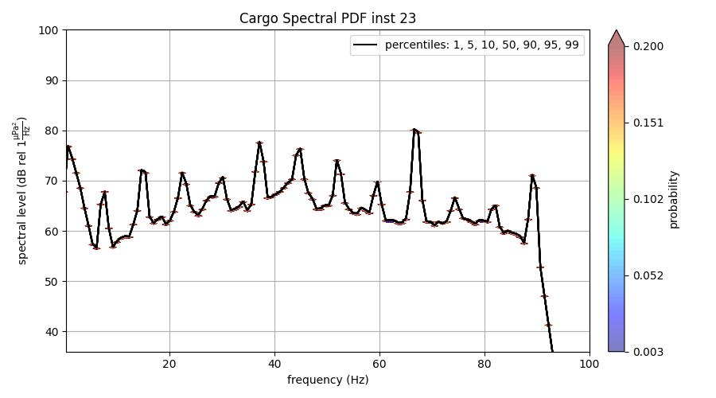
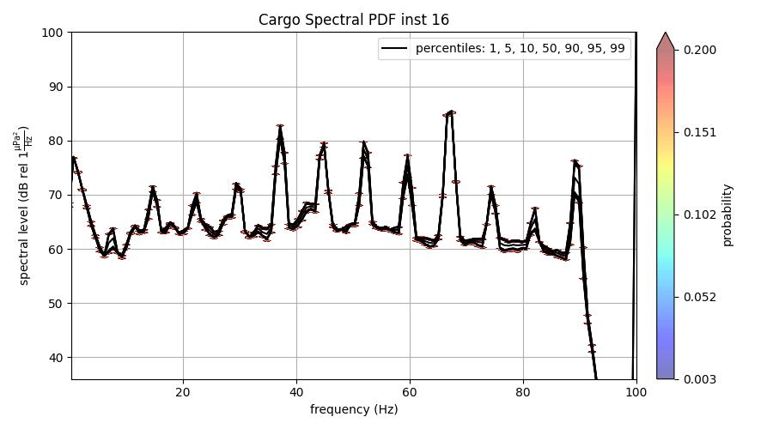

MMSI 356190000 CC
Range: 4.69-4.85 km
Speed: 8-10 knots
Range: 3.82-3.99 km
Speed: 12 knots
Range: 2.07-2.11 km
Speed: 12 knots
Range: 2.32-2.46 km
Speed: 13 knots

Slide 6
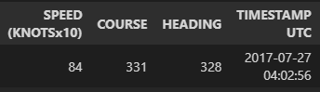
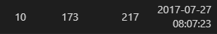
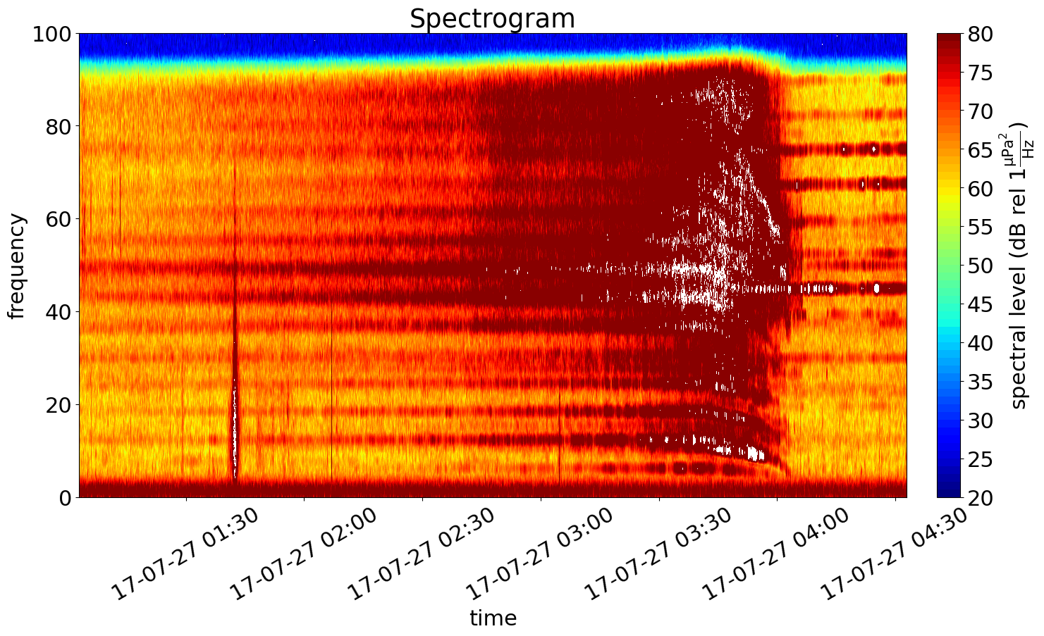
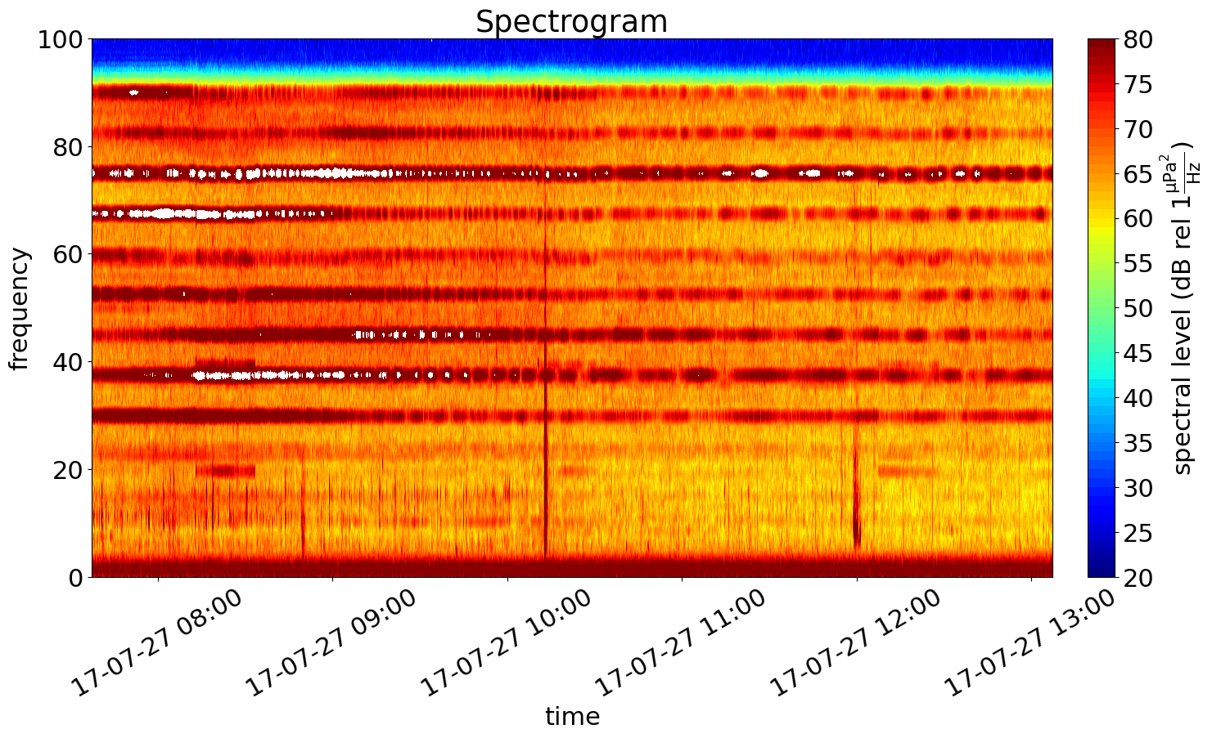
MMSI 356190000 CC
3 hours before start time (until 04:36)
5 hours after end time

Slide 7
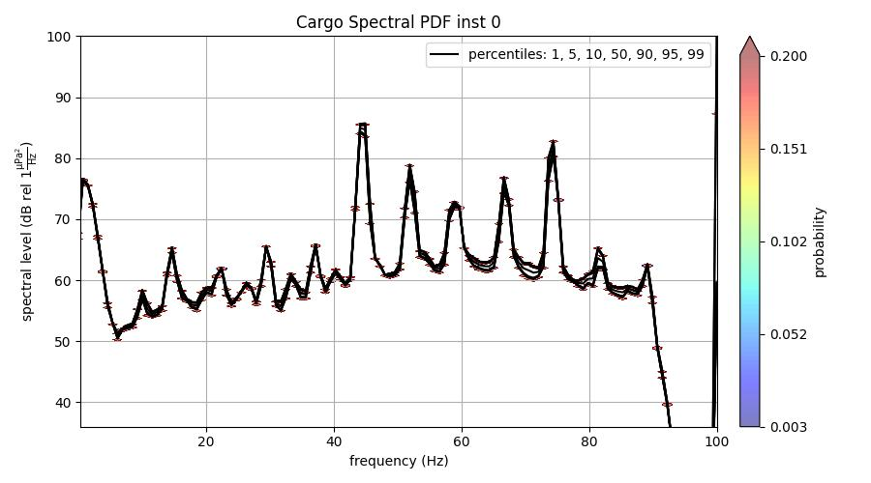
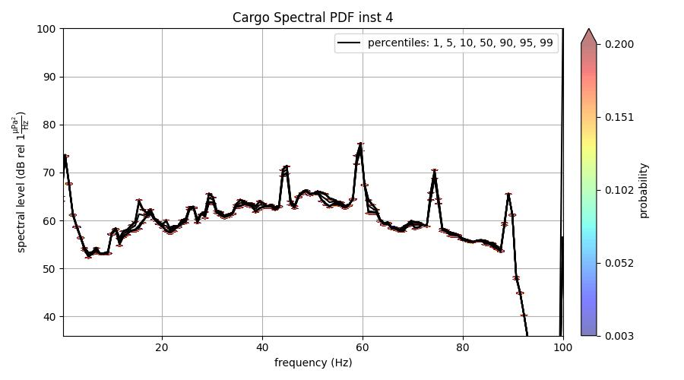
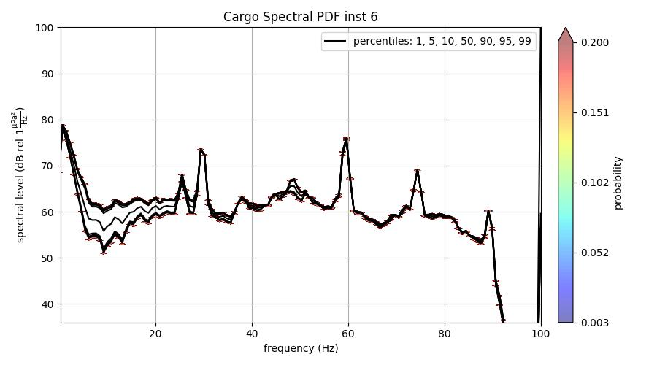
MMSI 356190000 AB
Range: 1.17-1.22 km
Speed: 6-9 knots
Range: 3.34-3.6 km
Speed: 10-12 knots
Same listed info, different psd files used

Slide 8
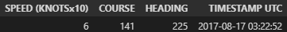
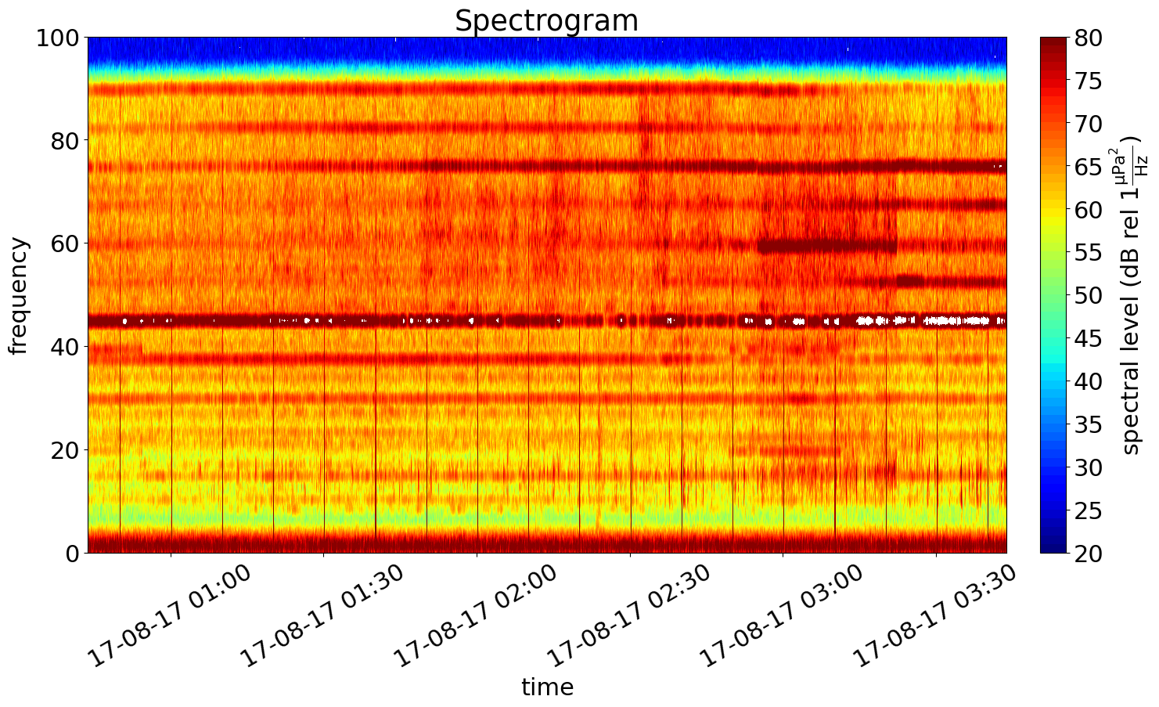
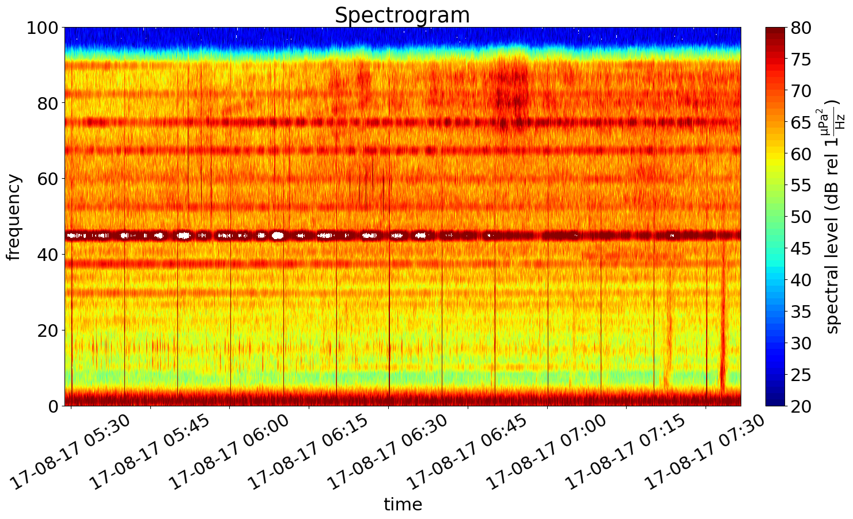
MMSI 356190000 AB
3 hours before start time
3 hours after end time

Slide 9

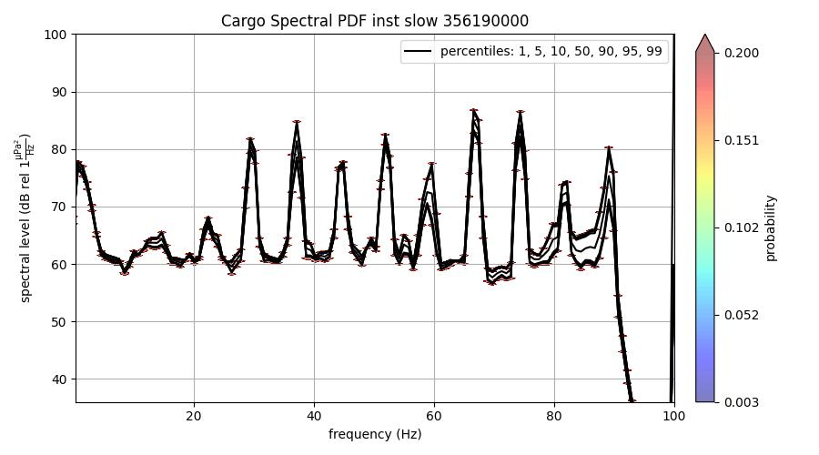
MMSI 356190000
Axial Base
Range: 1.17-1.22km
Speed: 6-9 knots
Central Caldera
Range: 1.21 – 1.73km
Speed: 9-10 knots

Slide 10
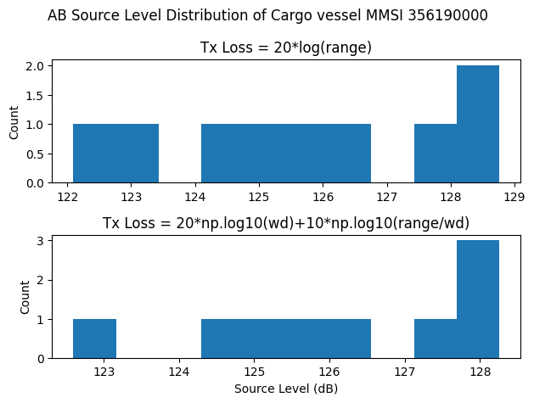
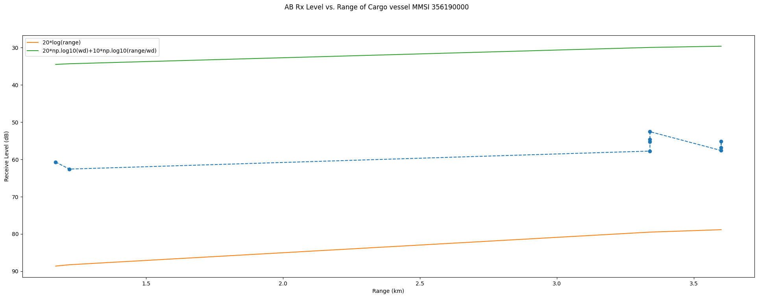
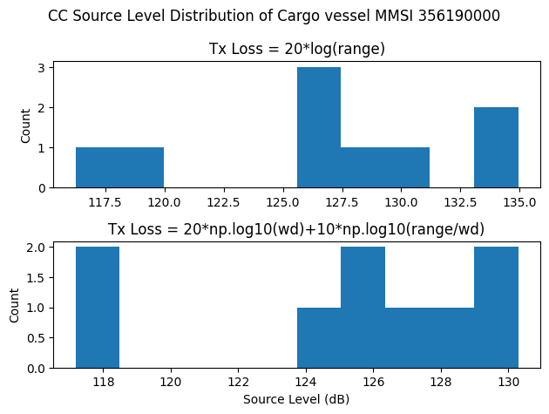
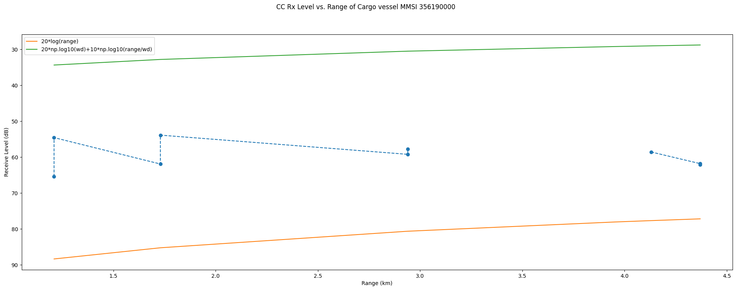
MMSI 356190000

Slide 11
MMSI 352358000

Slide 12
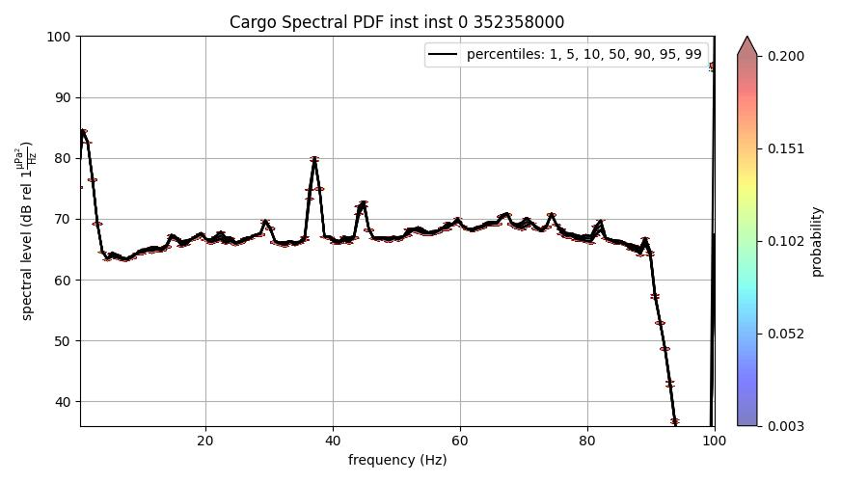
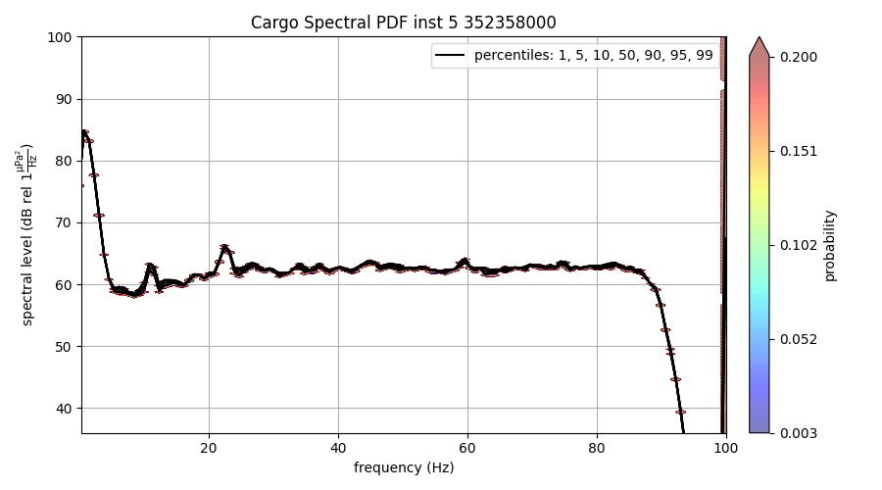
MMSI 352358000 CC
Range: 4.09-4.28 km
Speed: 29-30 knots
20 min. timeframe
Range: 4.20-4.46 km
Speed: 24-26 knots
8 min. timeframe
25 min. after other plot

Slide 13
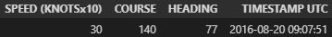
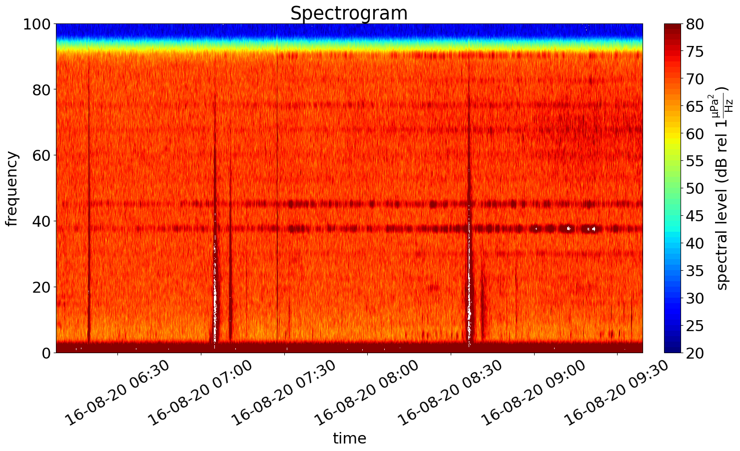
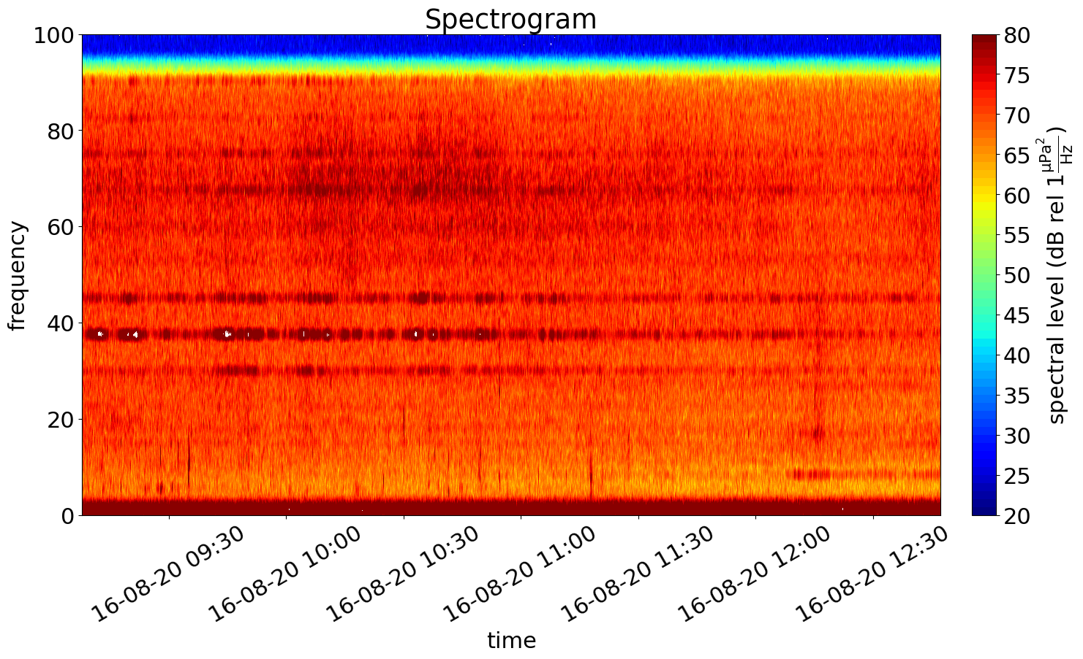
MMSI 352358000 CC
3 hours before start time
3 hours after end time

Slide 14
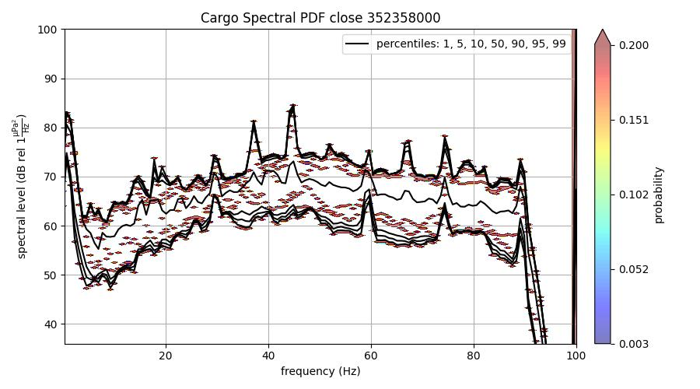
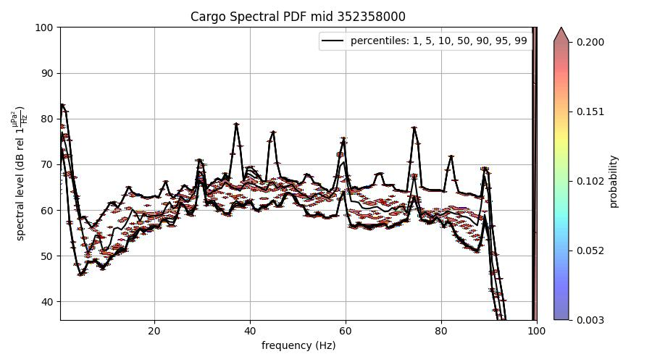
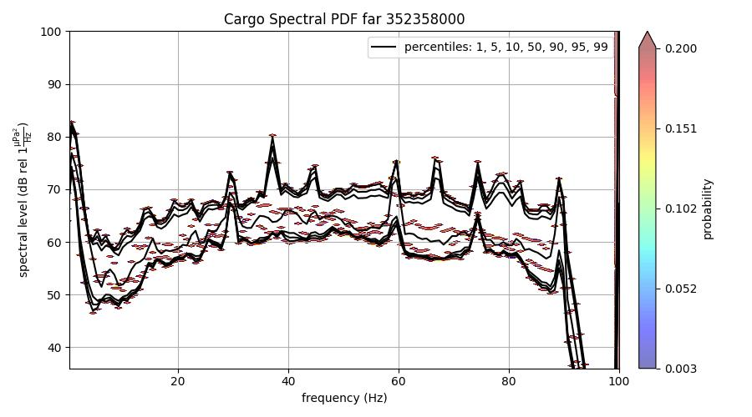
MMSI 352358000 AB
Range: 1.47-1.89 km
Speed: 22 knots
Range: 2.3-2.75 km
Speed: 22-23 knots
Range: 3.63km
Speed: 24 knots

Slide 15
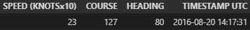
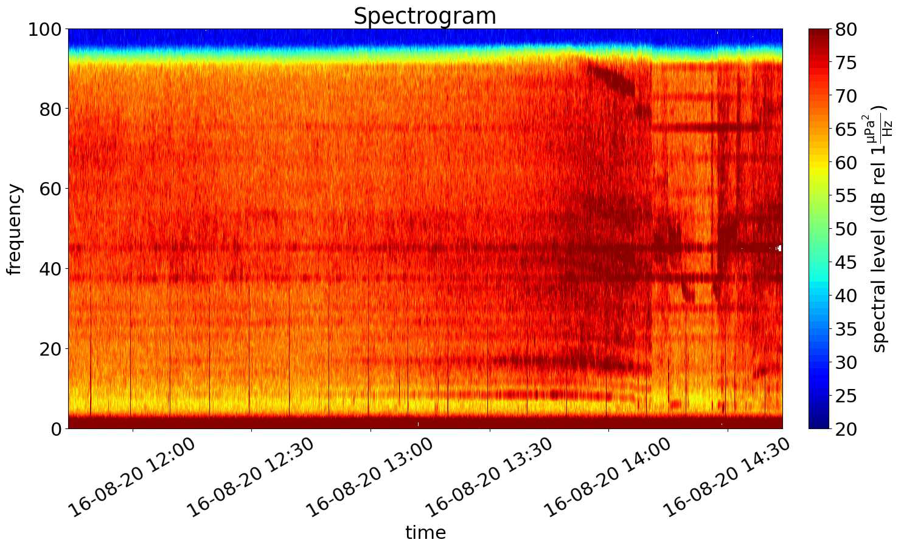
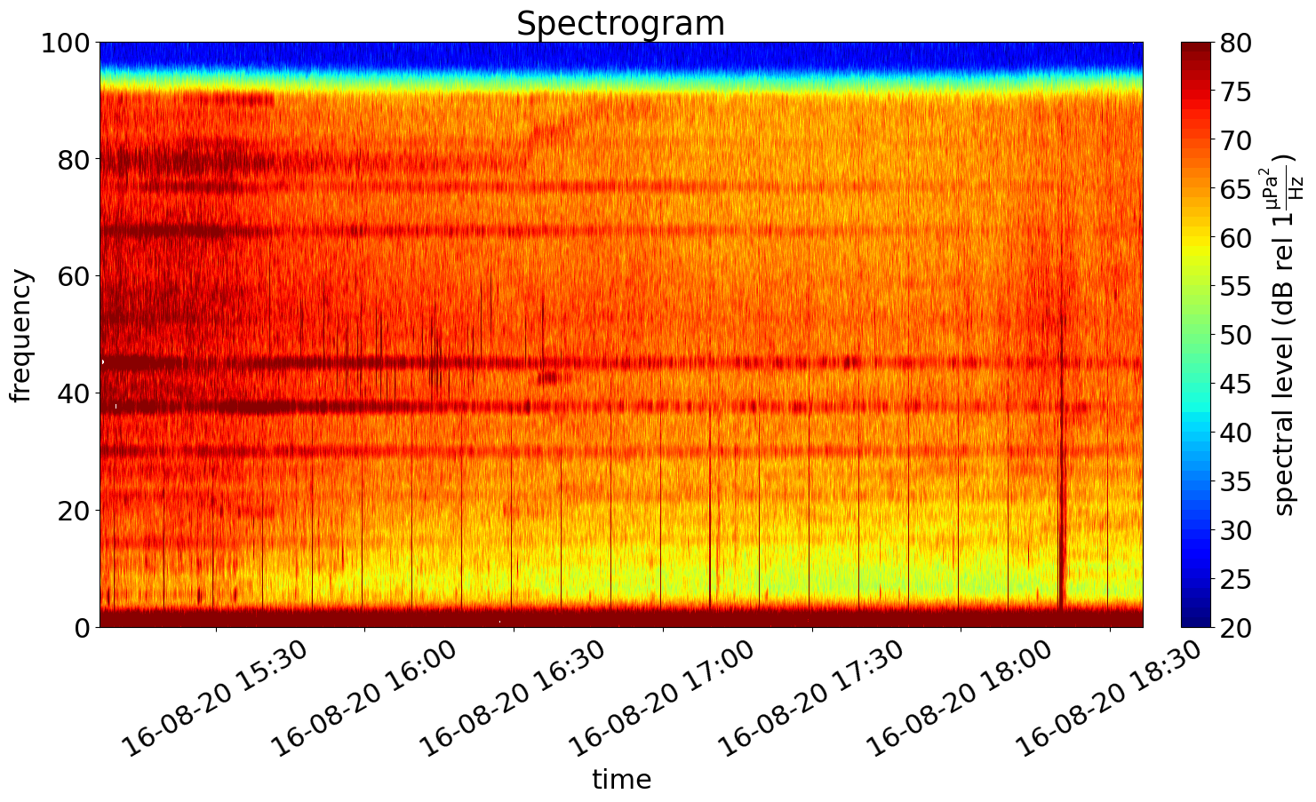
MMSI 352358000 AB
3 hours before start time
3 hours after end time

Slide 16
MMSI 352358000
Axial Base
Range: 3.63km
Speed: 24 knots
Central Caldera
Range: 4.09-4.28 km
Speed: 29-30 knots

Slide 17
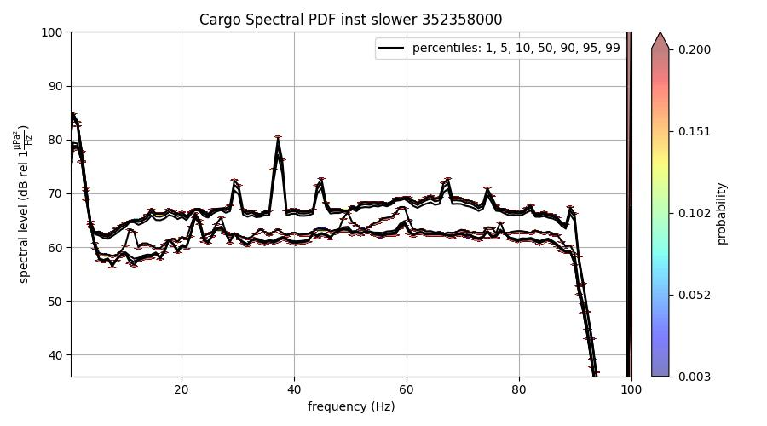
MMSI 352358000
Axial Base
Range: 3.63km
Speed: 24 knots
Differences in graph caused by the different psd pickle files associated to the rows in the dataset
Central Caldera
Range: 4.2 km
Speed: 24 knots

Slide 18
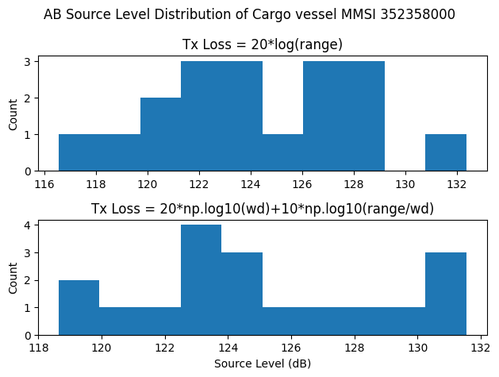
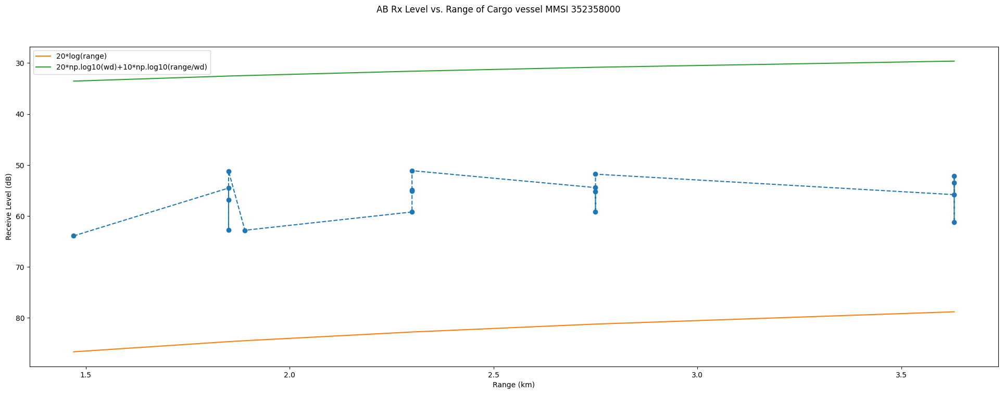
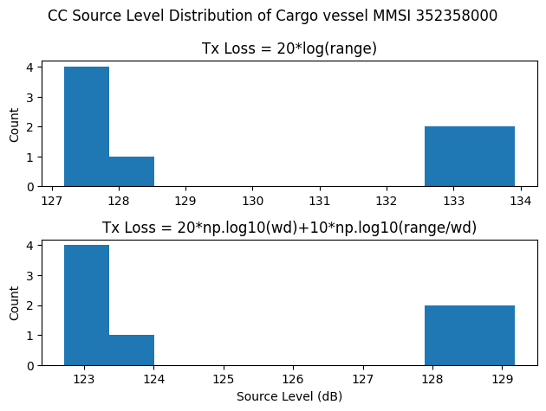
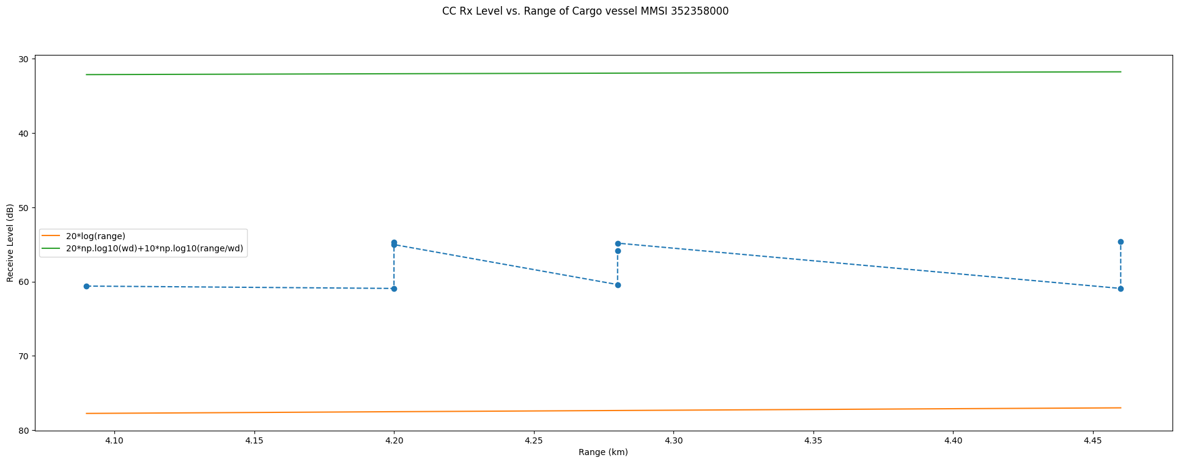
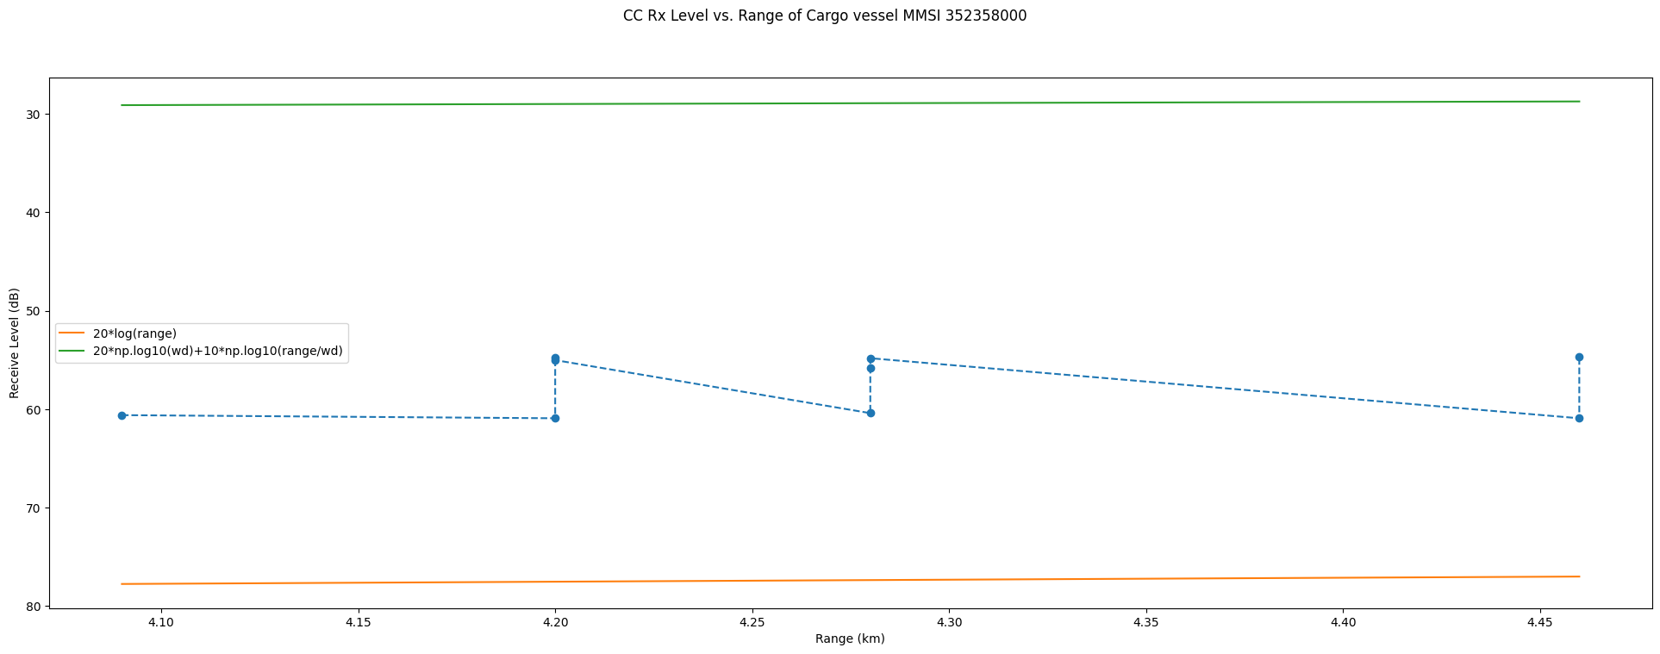
MMSI 352358000

Slide 19
MMSI 538005544

Slide 20
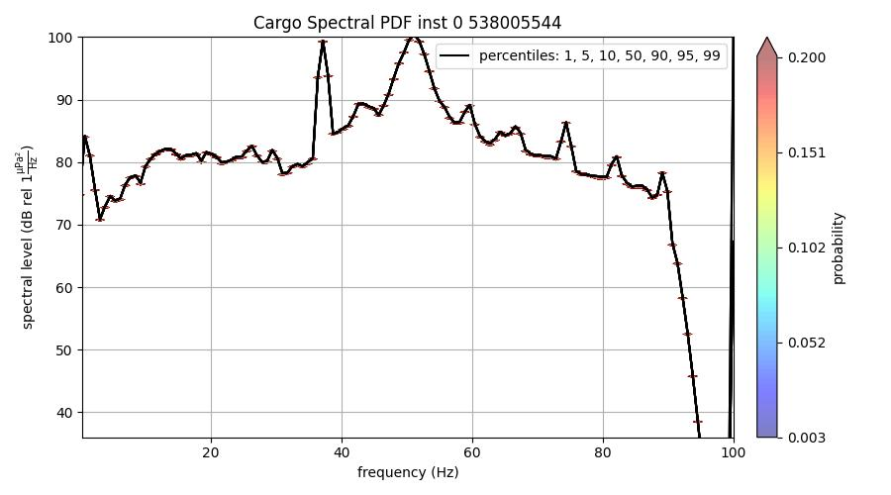
MMSI 538005544 CC
Range: 1.74-2.23 km
Speed: 87-90 knots
2 rows, both use same psd file

Slide 21
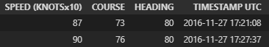
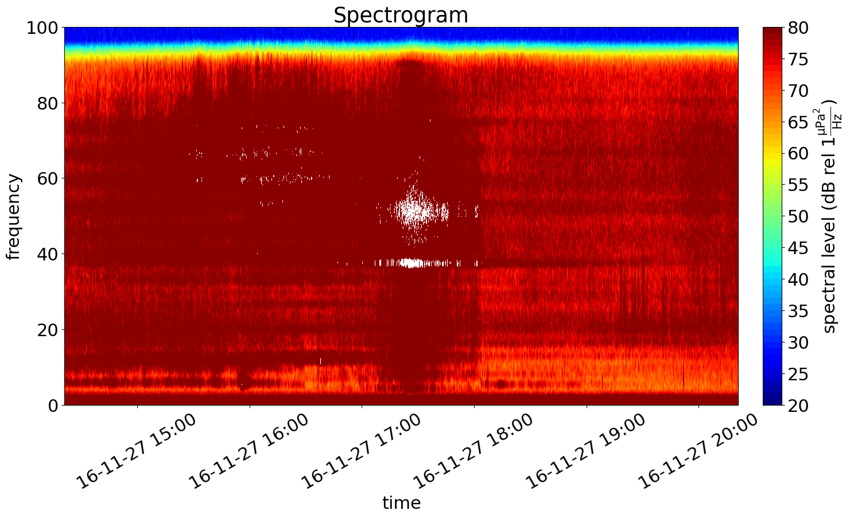
MMSI 538005544 CC
3 hours before start time
3 hours after end time

Slide 22
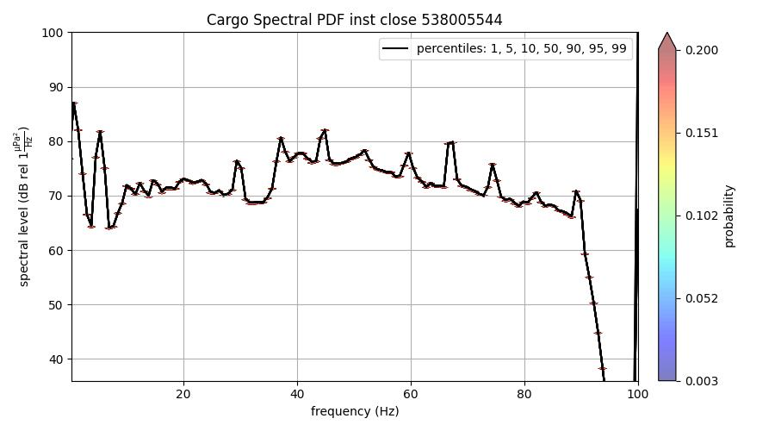
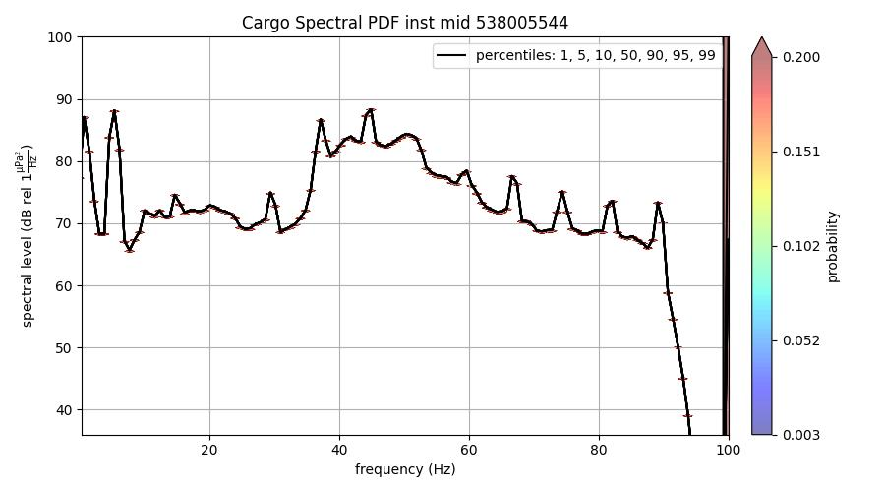
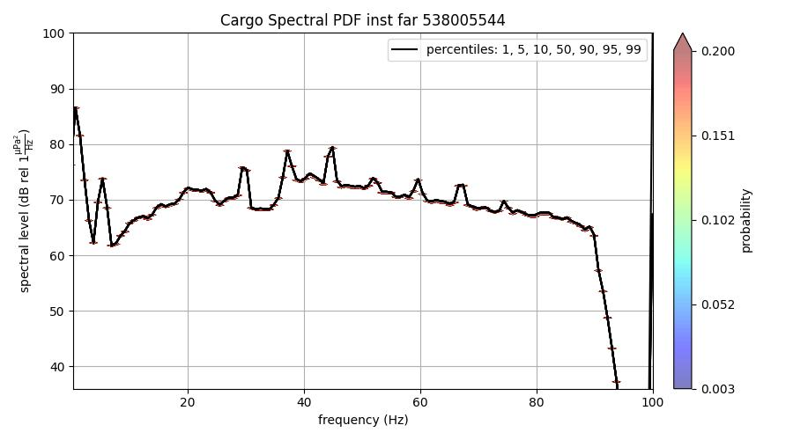
MMSI 538005544 AB
Range: 0.99 km
Speed: 70 knots
Range: 1.88 km
Speed: 71 knots
Range: 4.67 km
Speed: 70 knots

Slide 23
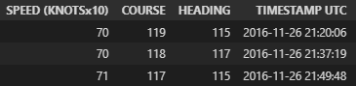
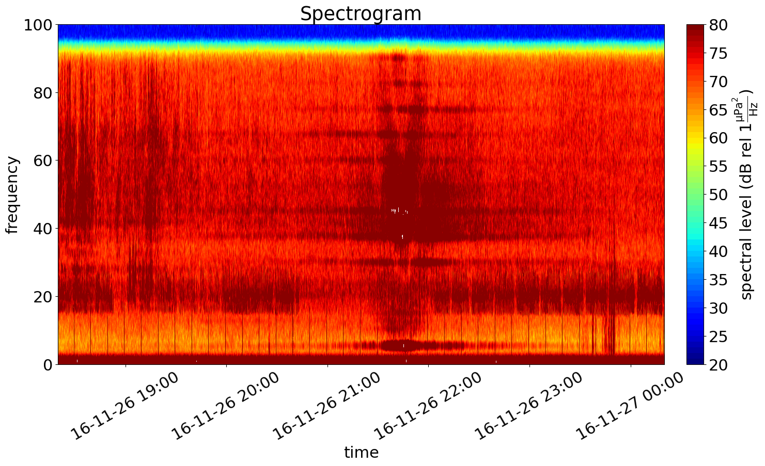
MMSI 538005544 CC
3 hours before start time
3 hours after end time

Slide 24
MMSI 352358000
Axial Base
Range: 1.88 km
Speed: 70 knots
Central Caldera
Range: 1.73-2.23 km
Speed: 87-90 knots

Slide 25
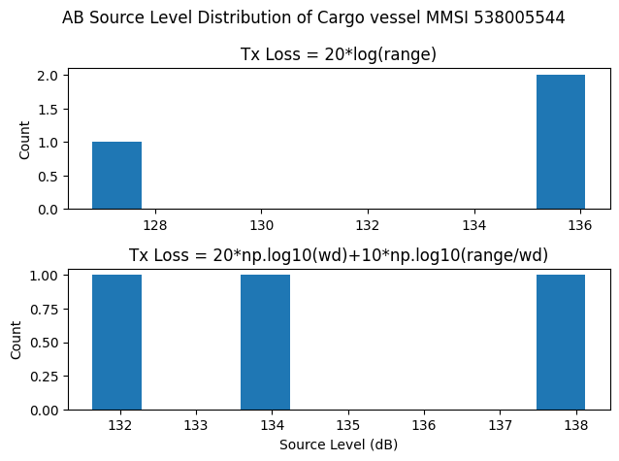
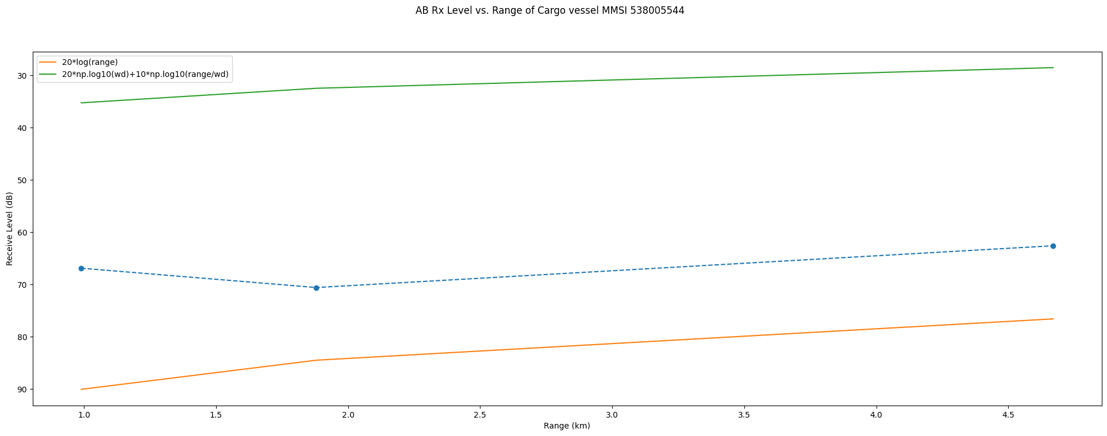
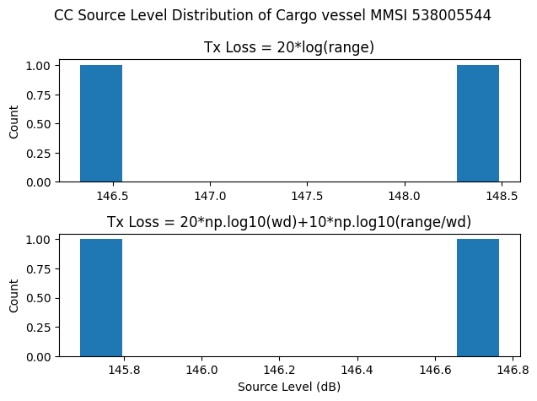
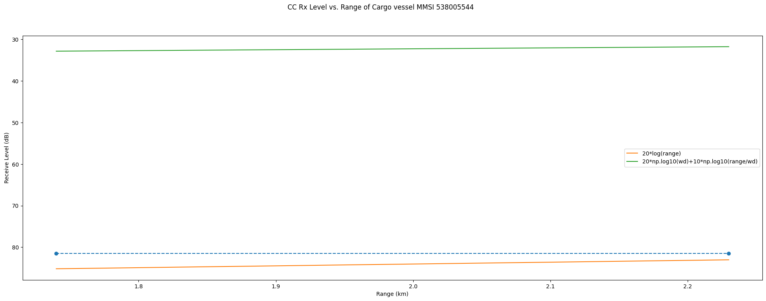
MMSI 538005544

